Slide 1
Coupa Supplier Portal (CSP) Training

Slide 2
11
How to Correct Invoices

Slide 3
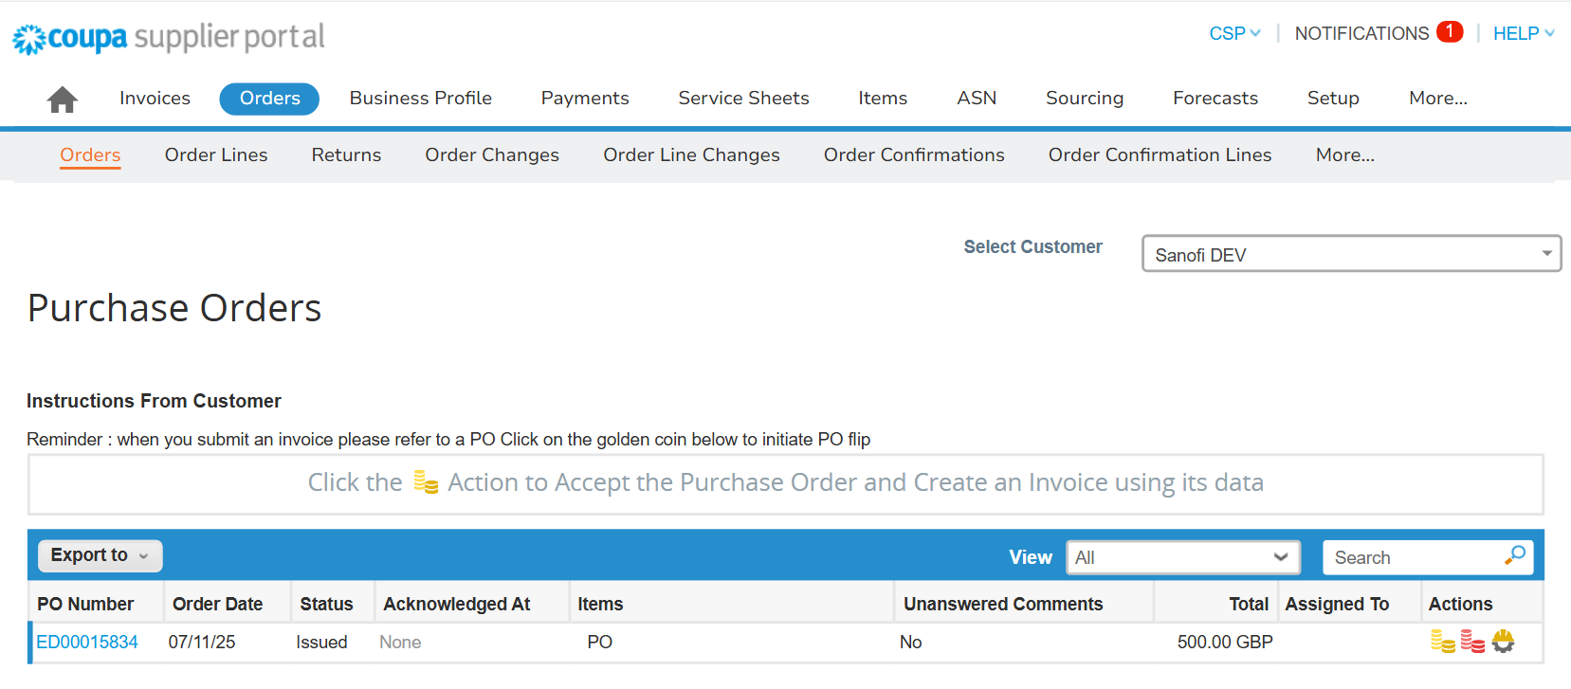
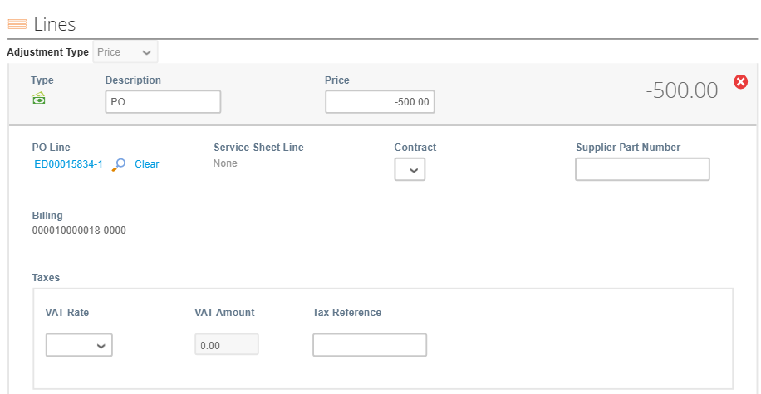
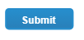
EXAMPLE
How to Correct Invoices (1/2)
1
How to Correct Invoices (1/2)
If you have already submitted an invoice with the wrong unit price, you must issue a credit note for the invoiced amount to cancel it. Then, submit a new invoice with the correct unit price.
Step 1: Create a credit note with the same amount:
Select the “Orders” tab
Under the “Orders” sub-tab, use the search bar to search for the PO
Click on the red coins icon to create a credit note
On the credit note creation page, edit the “Price” or “Qty” field and ensure value is negative and can fully balance out the invoice value as submitted in Step 1
Once ready, scroll down and submit the credit note*
2
3
4
*Note: To find detailed instructions on Credit Note creation, please navigate to “How to Submit Credit Notes” section.
5

Slide 4
EXAMPLE
How to Correct Invoices (2/2)
6
How to Correct Invoices (2/2)
Once the credit note has been approved, go back to the “Orders” tab and submit a new invoice with the correct amount.
Step 2: Submit an invoice with the correct amount:
Select the “Orders” tab
Under the “Orders” sub-tab, use the search bar to search for the PO
Click on the yellow coins icon to create an invoice
On the invoice creation page, ensure to edit and submit the invoice with the accurate amount*
7
8
9
*Note: To find detailed instructions on Credit Note creation, please navigate to “How to Submit Invoices” section.

Slide 5
12
How to Submit Invoices with Discounts

Slide 6
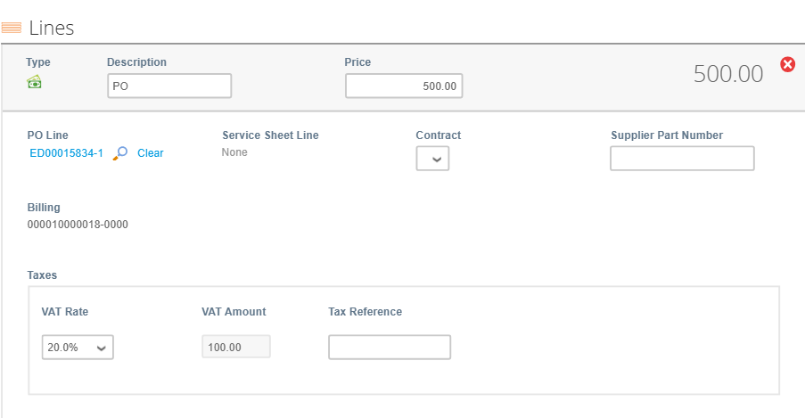
EXAMPLE
How to Submit Invoices with Discounts (1/2)
1
How to Submit Invoices with Discounts (1/2)
To apply a discount to an invoice, you must first submit the full invoice, then issue a separate credit note for the discounted amount.
Step 1: Submit a PO-backed invoice in full:
Select the “Orders” tab
Ensure to select Sanofi in the “Select Customer” field
Under the “Orders” sub-tab, use the search bar to search for the PO
Click on the yellow coins icon to create an invoice
On the invoice creation page, ensure to submit the invoice with the full amount*
2
3
4
5
*Note: To find detailed instructions on Invoice creation, please navigate to “How to Submit Invoices” section.

Slide 7
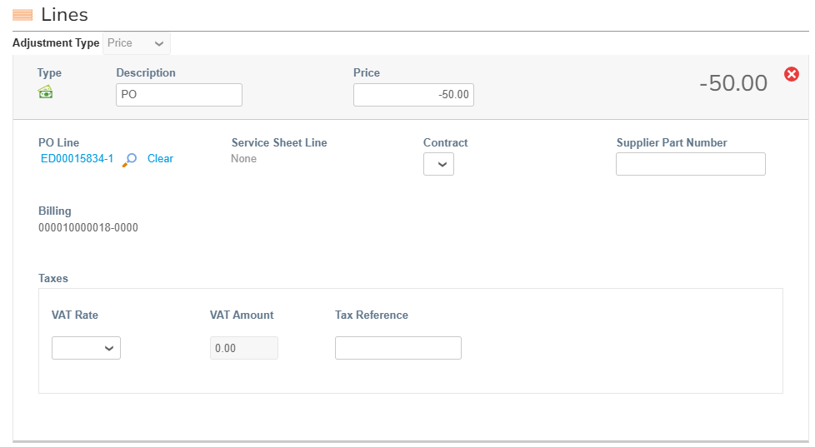
EXAMPLE
How to Submit Invoices with Discounts (2/2)
6
How to Submit Invoices with Discounts (2/2)
After successfully submitting the invoice, navigate back to the “Orders” tab and create a credit note against the same purchase order to apply the discount.
Step 2: Create a credit note for the discount amount:
Select the “Orders” tab
Under the “Orders” sub-tab, use the search bar to search for the PO
Click on the red coins icon to create a credit note
On the credit note creation page, edit the value in the “Price” field and ensure value is negative
Once ready, submit the credit note*
7
8
9
*Note: To find detailed instructions on Credit Note creation, please navigate to “How to Submit Credit Notes” section.

